Slide 1
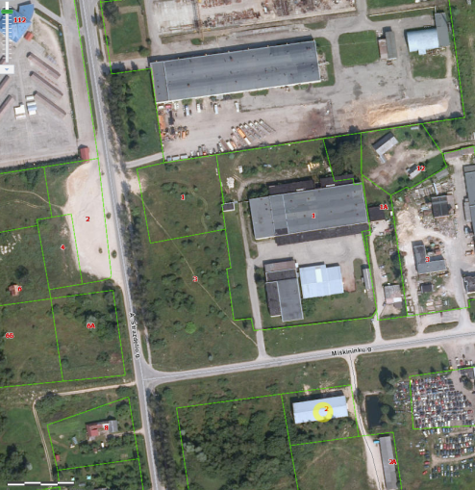

Commercial Land
Rokiskis District Municipality Administration
Plan of the land Photo of the land
Address | Rokiskis town, Strazdelio str. 3
Lot size | 0,6758 Ha
Electricity | 20m distance to substation of power system
Water | 10-30 m, d150 mm distance to water network
Telecommunications | 40 m distance to internet, telephone network
Distance to the main road | 0,015Km
Price/other conditions | Has not offerred for sale at an auction Detailed plan has prepared Land is commercial

